Slide 1
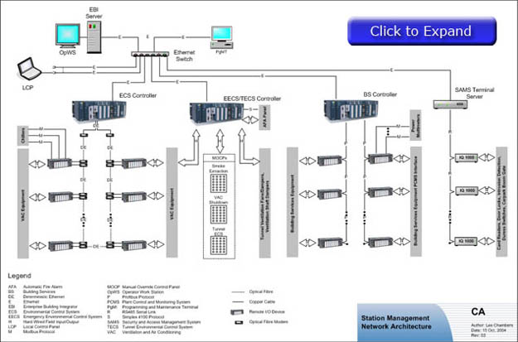
Definition
An outline of a system.
The base of computer
software practice.

Slide 2

Goals
Reliability
Secure
Extensible

Slide 3
History
It involved in the late 1960s, but became prevalent in the early 1990s.
Research of Edsger Dijkstra in 1968 and David Parnas in the early 1970s.
Relationship between software architecture and human being.

Slide 4
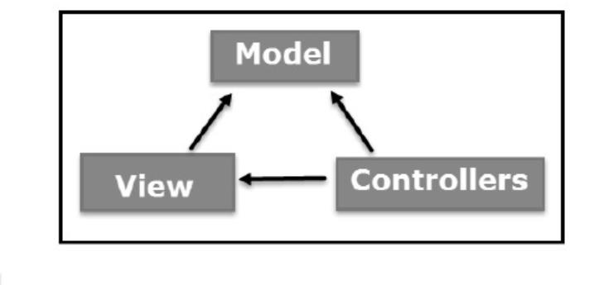
correlation
Association
Aggregation
Composition
Inheritance/Generalization
Realization
Dependence
Example: Model-View-Controller

Slide 5
Process of software system architecture
Step 1
∙Introduction to the demands
∙Demand analysis
∙Complexity analysis
∙Preliminary design
---------------------------------
Step 2
∙Overview the architecture
∙Core functional Process
∙Design details
∙Architecture improvement planning
Introduction
Analysis
Design
demands
complexity
Preliminary System architecture
overview
Core process
Design details
Detailed architecture
Architecture improvement
Final architecture

